Slide 1
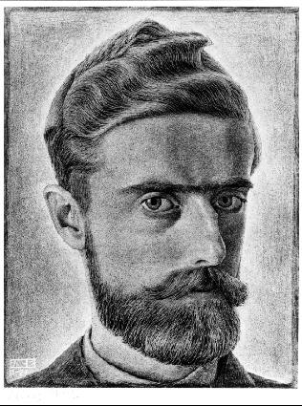
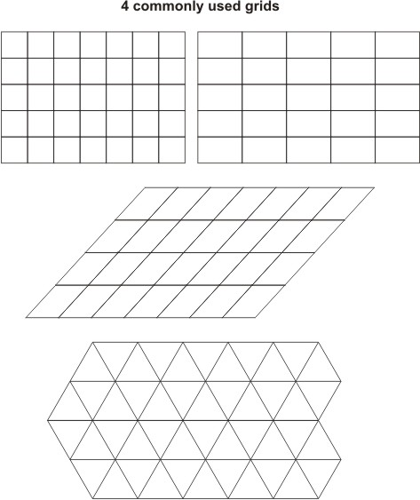
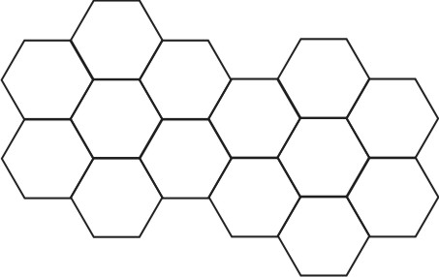
Page 50
Tessellation
Tiling to fill the plane with no gaps or overlaps
Page 51
Page 52
Michael S. Schneider
www.constructingtheuniverse.com
Page 53

Slide 2
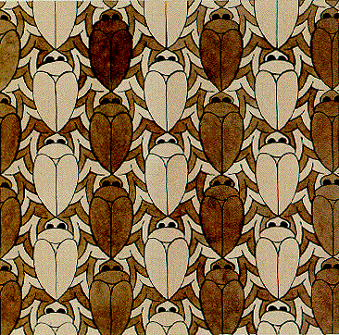
1 - Glide
One form repeats and
moves in the same direction

Slide 3
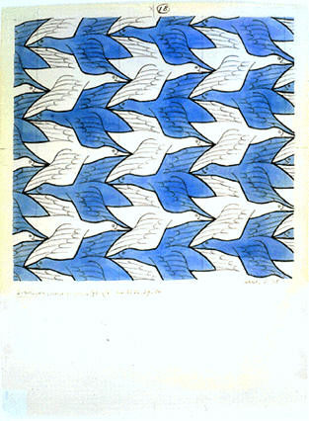
2 - Glide-Reflection
The same shape moves in alternating directions

Slide 4
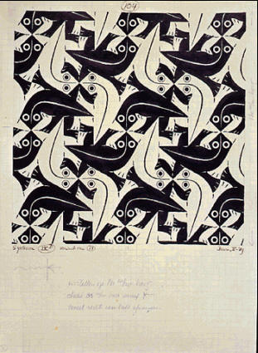
3 - Rotation
The same shape rotates around a point.
Where are the points of rotation?

Slide 5
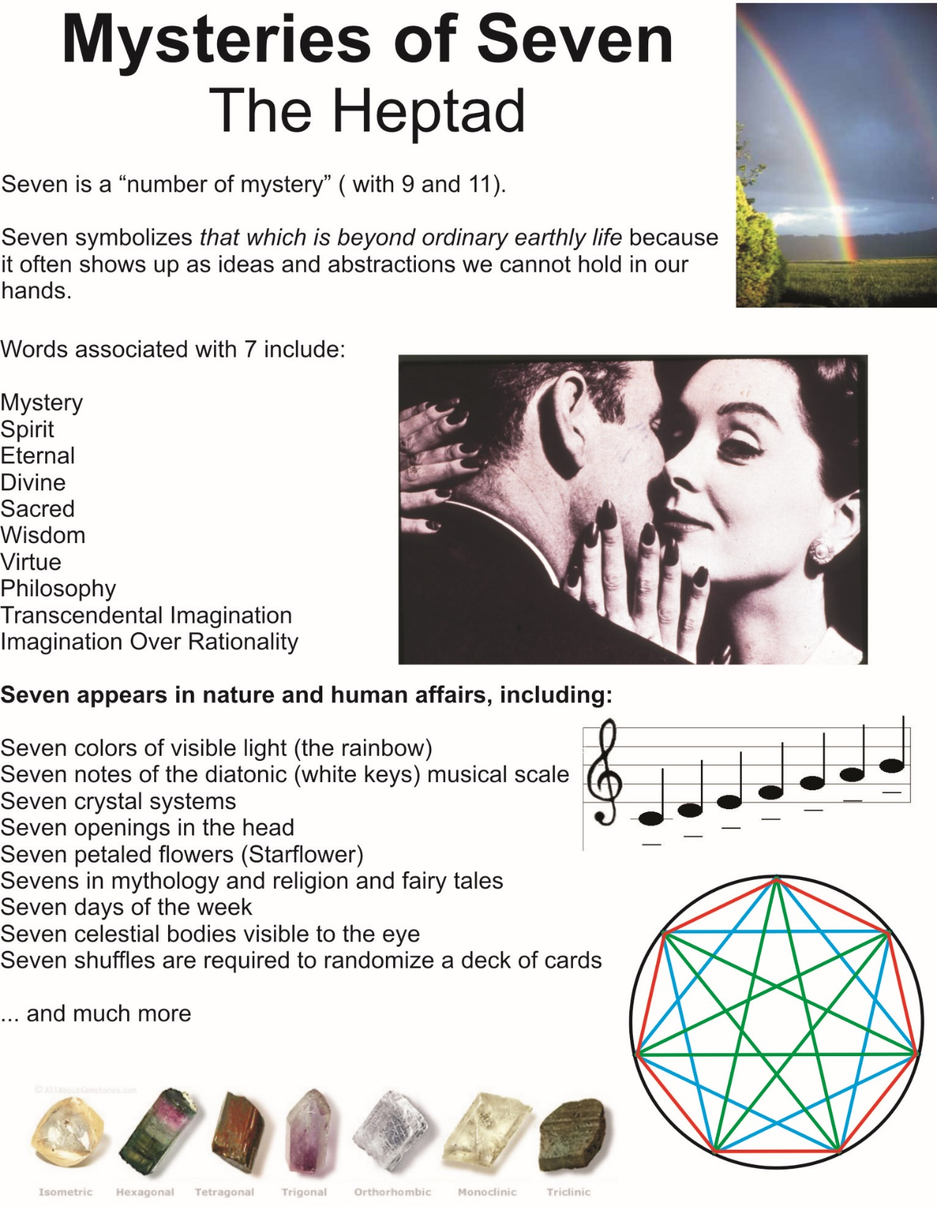

Slide 6
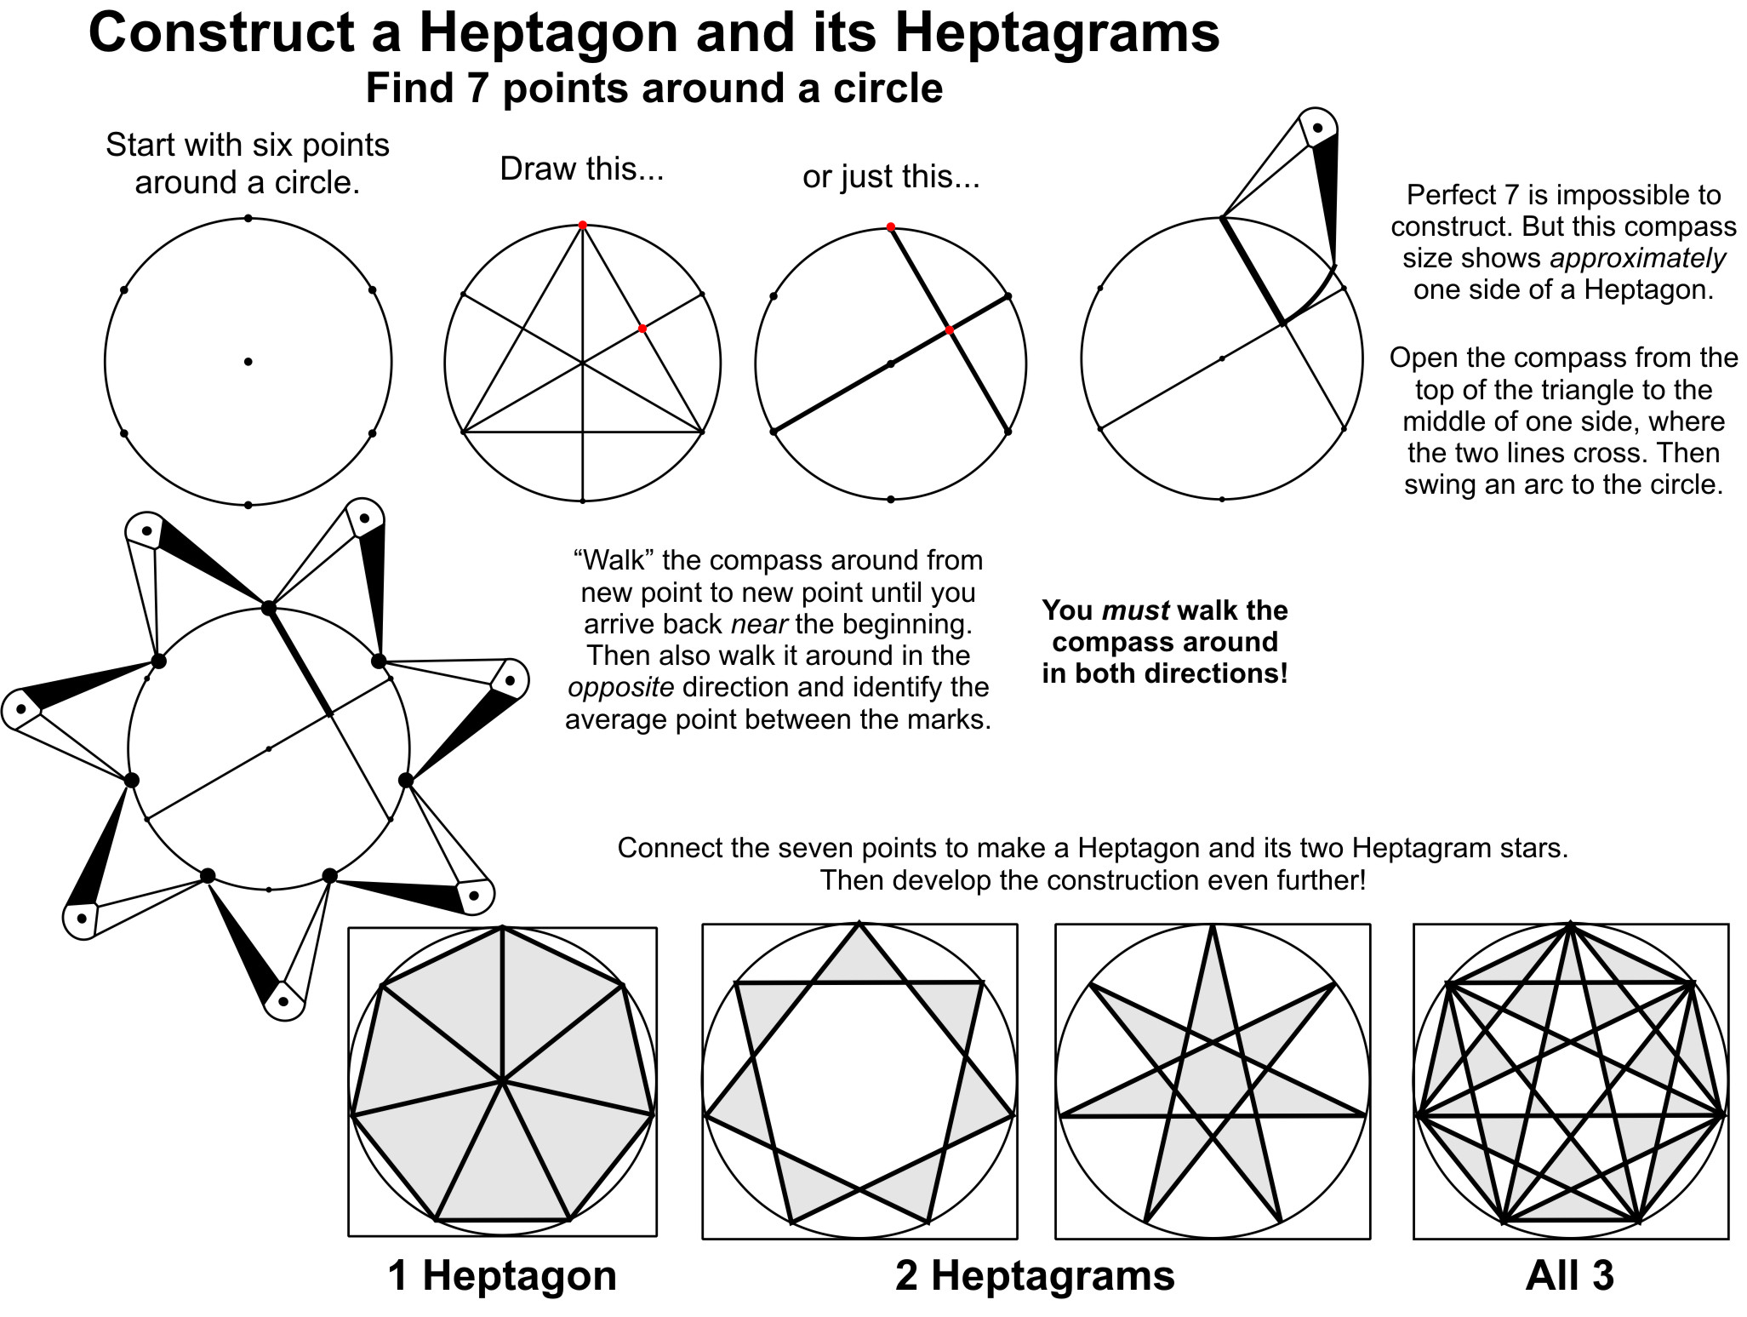

Slide 7
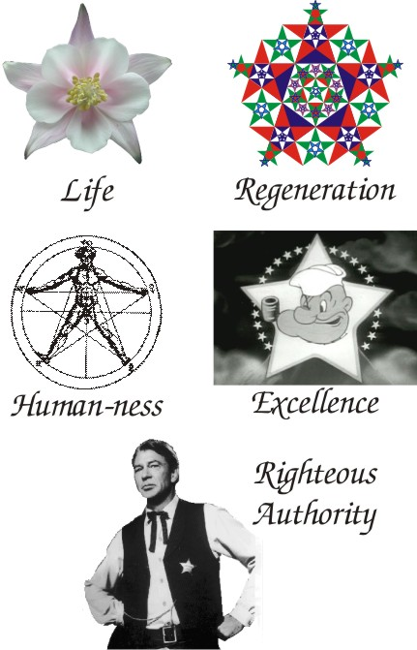
Pentagonal Symmetry
Page 83
5 as a Symbol

Slide 8
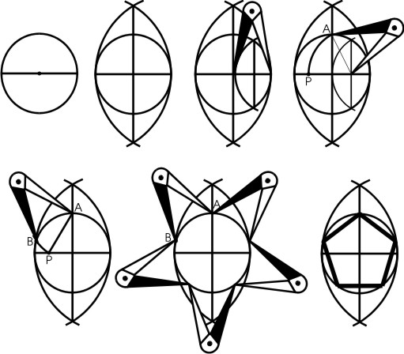
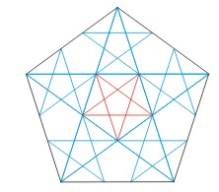
Constructing a Pentagon
with a Compass and Straightedge
Page 84
Almond!
Mini-
almond
Walk it around in both directions!

Slide 9
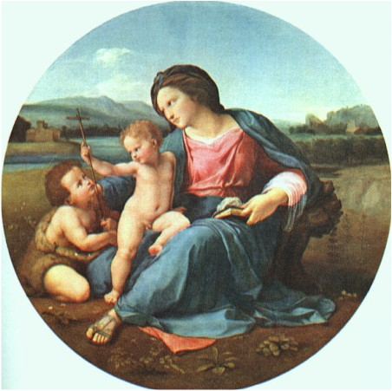
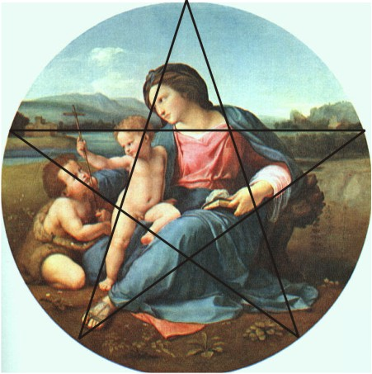
Page 86

Slide 10
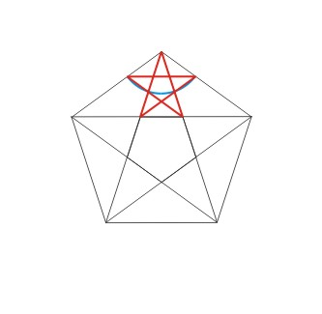
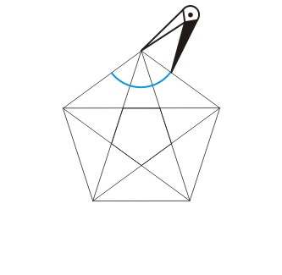
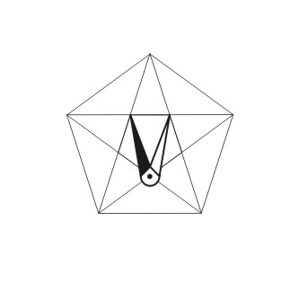
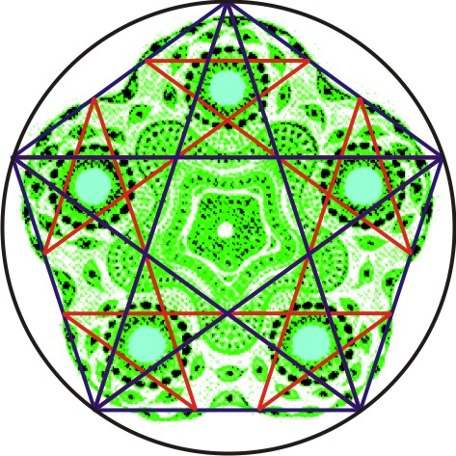

Slide 11
0, 1, 1, 2, 3, 5, 8, 13, 21, 34, 55, 89, 144, 233, …
The Fibonacci Numbers
0 + 1 = 1
1 + 1 = 2
1 + 2 = 3
2 + 3 = 5
3 + 5 = 8
5 + 8 = 13
8 + 13 = 21
13 + 21 = 34
21 + 34 = 55
34 + 55 = 89
55 + 89 = 144
89 + 144 = 233
144 + 233 = 610
233 + 610 = …
The idea of the Fibonacci sequence is very simple:
Starting with 0 and 1, each two numbers add together to make the next number.
The Fibonacci Series never ends…
Who first thought about this?

Slide 12
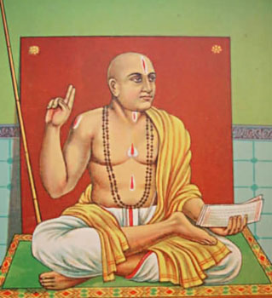
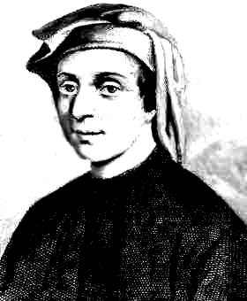
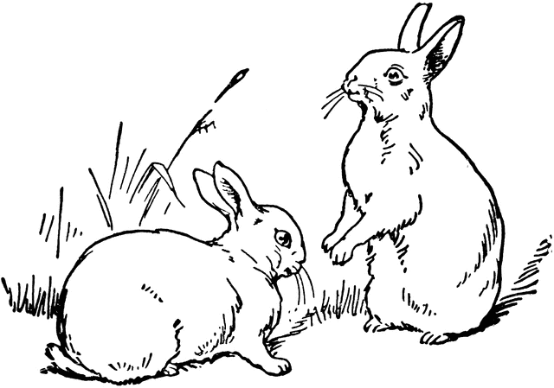
Pingala
In the 3rd century BC a man named Pingala wondered how many ways there are to combine short (S) and long (L=2S) syllables so that their total is always the same number of syllables.
The Fibonacci Series
# of Syllables
1
2
3
4
5
#s of Ways
1
2
3
5
8
0, 1, 1, 2, 3, 5, 8, 13, 21, 34, 55, 89, 144, 233, …
Leonardo of Pisa
circa 1175 – c 1250
Fibonacci
Rabbit Puzzle

Slide 13
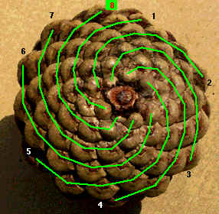
Page 99

Slide 14
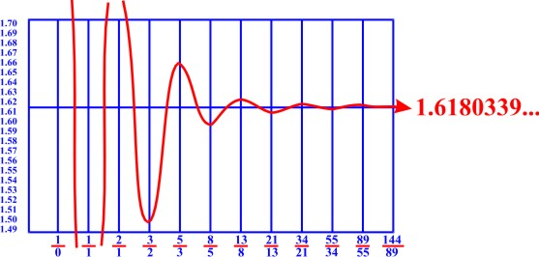
The Golden Ratio
Fibonacci Fractions tend towards the ideal Golden Ratio
Golden Ratio
1.618
1.62
Φ

Slide 15

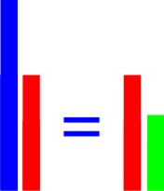
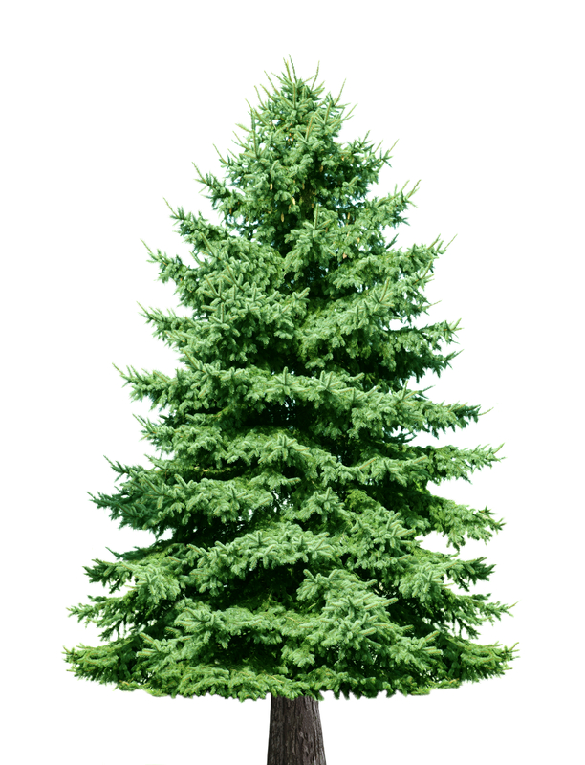
The Golden Ratio
= 1.618…
1
.618
The parts simultaneously balance with each other and with the whole.
That’s why one branch of a tree often resembles the whole tree!
Whole
The whole is to the large part, as the large part is to the small part.
Large Part
Large Part
Small Part

Slide 16
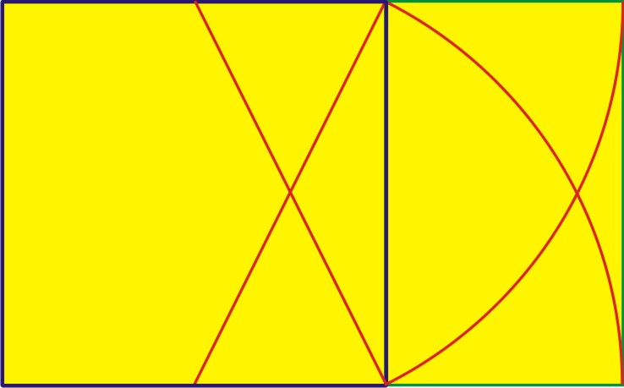
The whole is a large Golden Rectangle.
And this small rectangle added onto the square is a small Golden Rectangle!
1
1
.618
The area of the large Golden Rectangle is to the area of the square
as
the area of the square is to the area of the small Golden Rectangle!

Slide 17
Page 106

Slide 18
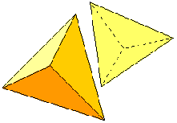
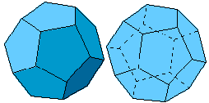
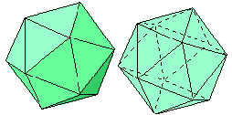
The Platonic Solids
Page 114
1
Tetrahedron
In three dimensions there are
only these five ways to enclose 3D using only one shape:
3 are made of triangles
1 is made of squares
1 is made of pentagons
Their names come from their number of faces:
1) Tetra-hedron - made of 4 equilateral triangles
2) Hexa-hedron (Cube) - made of 6 squares
3) Octa-hedron - made of 8 equilateral triangles
4) Dodeca-hedron - made of 12 regular pentagons
5) Icosa-hedron - made of 20 equilateral triangles
2
Hexahedron
Octahedron
3
Dodecahedron
4
5
Icosahedron

Slide 19
They’re called
The 5 Regular Polyhedra
Poly- = “Many”
-Hedra = “Seats” (faces)
Page 114
But they’re called "Regular" polyhedra which means that
everything about them is equal:
In each:
All corners are an equal distance from the center.
All edge lengths are equal.
All faces are identical regular polygons.
All angles are the same.

Slide 20
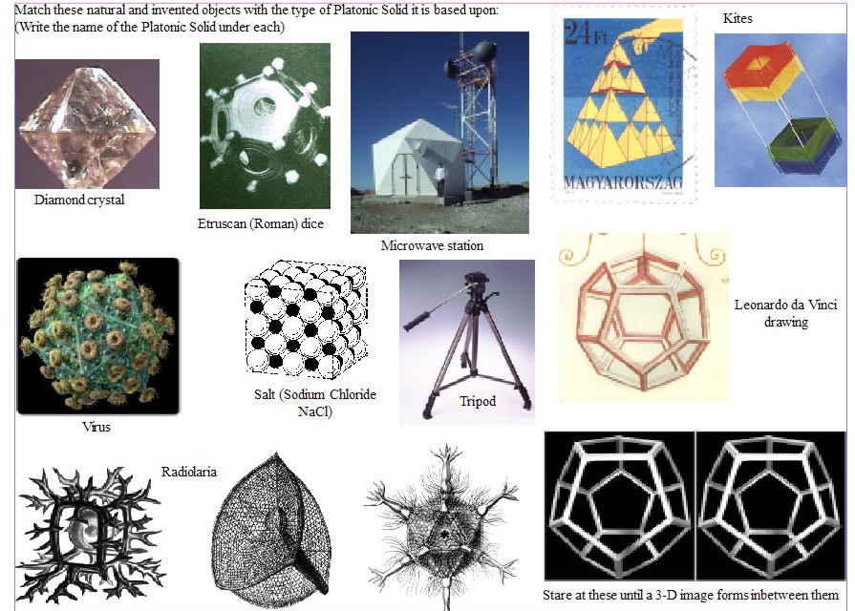
Page 115
Hexa
Dodeca
Octa
Tetra
Icosa
Icosa
Hexa
Tetra
Dodeca
Dodeca
Hexa
Tetra
Icosa

Slide 21
